Slide 1
T522 2025 Deliverables
Learning Design isn’t linear.
Practice the Process!

Slide 2
Deliverable 1 (due EOD 9/10)

Slide 3
Deliverable 1: Challenge Map and Research
Focus Skill: Using Research Literature
Pick a challenge that is unfamiliar that relates to a context that IS familiar and accessible. For instance, the challenge of language (unfamiliar) for international students (accessible), or the challenge of mental health (unfamiliar) for purposeless employees (accessible).
Use the Challenge Map to capture your initial assumptions.
Use Gen AI to extend and revise the Challenge Map and to identify specific obstacles you want to address.
Use Elicit, Perplexity, or other Deep Research AI tools to find, sort, and select at least 3 research articles that you think will be helpful.
Revise the Challenge Map with research supporting your targeted area and emerging constructs.

Slide 4
My unfamiliar challenge:
In this accessible context:
Use the Challenge Map to capture your initial assumptions & identify the obstacle(s)/root cause(s) you want to address.
You will make and revise multiple maps. Keeps copies of each revision to retrace your history.
Feel free to make maps in another tool, like Miro or Figma. Just include a link here so your TF can have access.
AND MAKE SURE TO PROVIDE PERMISSION TO COMMENT.
The Challenges
Language
Lack of Access
Skills Mismatch
Mental Health
Engagement

Slide 5
Spending time on their own by themselves becomes difficult
Many people experience this issue as they step into retirement phase
It is a protective factor for mental and physical health
Ind are not used to the routine of not having a routine
Leads to mental health issues such as depression or decline in cognitive health
Can cause low self esteem
A large portion of the population in the next 5 years is going to retire. Many face the challenge of entering an unknown space without support or planning
Why important to address?
Retirement is often considered as a phase of not doing anything or simply relaxing. Although this phase excites most people, it gets difficult for people to adjust to it.
Many senior adults have the notion of ‘giving back to the society’. Not having appropriate channel to do so can cause them to feel lost
Want to continue working/follow their passion
Identity and purpose loss for senior adults post retirement
Averseness to vulnerability
Gendered roles
Mobility and health issues
Obstacles to addressing?
Internalized ageism
Societal perception on ageism
V 1
Follows a long timeline
Fear of failure/motivation
Limited access to platforms

Slide 6
Assumptions
Identity and purpose loss for senior adults post retirement
Social identity is related to job people hold
Senior adults wants to engage productively when they retire
Senior adults often gets bored which leads to overthinking
Senior adults struggle to form a new routine post retirement

Slide 7
WHO
Include snippets, quotes, and screenshots highlighting your research. Annotate why you found the highlight useful.
Highlights from Your Research
By 2030, one in six people in the world will be aged 60 years or over.
Loneliness and social isolation are key risk factors for mental health conditions in later life.
One in six older adults experience abuse, often by their own carers.
Approximately 14% of adults aged 60 and over live with a mental disorder.
Mental disorders among older adults account for 10.6% of the total years lived with disability for this age group.
Many face risks of mental health conditions (depression and anxiety disorders), physical decline (reduced mobility, chronic pain, frailty, dementia ), and chronic illnesses that may require long-term care.

Slide 8
Highlights from Your Research
Include snippets, quotes, and screenshots highlighting your research. Annotate why you found the highlight useful.
Mental/cognitive well‑being (all studies): Four main determinants emerged in relation to the mental/cognitive well-being domain, namely, self-awareness, outlook/attitude, life-long learning, and faith.
Self-awareness: The determinant of self-awareness included self-esteem, self-achievement, resilience, body awareness, and sense of purpose
It was noted that having a good outlook and attitude towards the future impacted ageing in a positive way, rather than “awaiting death”
Life-long learning (e.g. reading, taking up a new hobby, or learning a new language), found in three studies, is intricately connected with outlook/attitude [14, 18, 20]. Thanakwang et al. specifies that “engaging in active learning” is very important in successful healthy ageing particularly in the field of technology [14]. Additionally, continuous learning has a good cognitive impact aiding in maintaining one’s cognitive function as they age.
Being in isolation has a large impact on mental health and immersing in faith was shown to support stability as well as increase motivation. Both of which support a good outlook towards life as the participants age and began to develop illnesses. Additionally, Robleda et al. found that participants reported that as you age it becomes more difficult to look forward to the future and immersing oneself in faith gave their life a higher sense of purpose
The older adults in this study do not report that high physical functioning is equated with successful aging, but, rather, engaging in social, cognitive, and physical activities are important while also being realistic and accepting that one will experience changes and challenges to engaging in such activities due to natural changes in the aging body. Therefore, one needs to accept such changes as natural and normal and make adaptations versus merely giving up and concluding they are unsuccessful at aging.

Slide 9
Retirement to them is a new concept and it takes time to adjust to the new routine
The gen has mostly been the working generation which had to work really hard due to their responsibilities, now that there responsibilities are sorted – they struggle to spend time by themselves
As their children grow up they are mostly staying alone
They are not used to staying idle
Mental health is a new concept for them – they never learnt it or were introduced to it
Why important to address?
Mental health programs are not mostly created for the elderly
Ignored group?
This group is a growing population and is mostly lonely
Self awareness or mental strength is low
Addressing mental health issues among elderly
Averseness to vulnerability
Gendered roles
Mobility and health issues
Obstacles to addressing? Why is it not happening?
V 3
Internalized ageism
Societal perception on ageism
Follows a long timeline
Fear of failure/motivation
Limited access to platforms

Slide 10
Formal learning structures are considered as avenues for job or employment which senior adults don’t need now
Life-long learning is a hobby?
Less number of opportunities or demand
Learning -> Cognitive health -> functional health
Why important to address?
Not all formal structures are accessible or affordable
The idea of learning is limited to a certain age group
Learning opportunities for senior adults are limited to formal structure
The idea of learning is limited to a certain age group
Accessibility of formal structures
Obstacles to addressing? Why is it not happening?
V 2
Connection between learning and cognitive health is not a commercial idea?
Less informal learning spaces
Digital learning structures

Slide 11
State and vet assumptions
1 | I believe mental health is an ignored topic of discussion amongst the senior adults and most senior adults struggle to accept that they have any issues
 | key-idp.iam.harvard.edu/idp/profile/SAML2/POST/SSO?execution=e1s1&_eventId_proceed=1
2 | I believe addressing mental health is important as it affects the overall well being of an individual
 | https://pubmed.ncbi.nlm.nih.gov/39394639/
3. | I believe desire to continue learning at an older age is coming from want more than need.

Slide 12
Is it though? Wasn’t tech always there? Then what is different about digital tech
Attach evidence for this
Technology was new to them when they were introduced to it.
Adults learn differently which is different from how children learn
Why important to address?
Technology evolves consistently– they almost always end up keeping up with the new technology
Tech products are mostly designed to solve for the problem/disease not for the human being
Assumption – explore it as another challenge area
Many senior adults finds it difficult to use the technology that is designed for them
Products when designed often aren’t co-designed with sr adults
Look for org doing this and those who aren’t
Attach evidence for this
Role of Learning design in AgeTech
AgeTech is health domain dominated
Healthcare or insurance: who bears the cost? (geography specific)
Obstacles to addressing?
V 4
Ask experts for this!
A counterargument often shared is that it is the caregiver who uses the tech [not all sr adults are primary users of the tech]
Not much research on how senior adults learn

Slide 13
Assumptions
1. Many senior adults finds it difficult to use the technology that is designed for them | https://hollis.harvard.edu/permalink/f/1mdq5o5/TN_cdi_proquest_journals_1907285803
2. Adults learn differently which is different from how children learn | https://cahnfellowsprograms.org/wp-content/uploads/2021/03/2A-drago-seversonJSD2011-1.pdf
3. Tech products are mostly designed to solve for the problem/disease not for the human being | https://bjsm.bmj.com/content/bjsports/49/23/1483.full.pdf
4. Products when designed often aren’t co-designed with sr adults

Slide 14
Highlights
The most important activity we can be engaged in for disease prevention is innovation related to the ‘how’. Innovation can be defined as new solutions designed from insights gained through empathic partnership with users. This type of innovation requires approaches such as human-centred design (sometimes referred to as user-centred design), an approach that uses validated methods to create programmes for the way people are, not for the way we think they are or wish they were.7 While this approach may seem self-evident, it is anything but established in prevention. Human-centred design (HCD) systematically observes people’s natural tendencies and elicits their goals, and then iteratively develops, tests and revises programmes to meet those goals.
Everett Rogers (2003) has called the knowledge stage of technology adoption. Rogers (2003) divides the knowledge stage into three distinct types of knowledge: awareness-knowledge, how-to knowledge, and principles-knowledge. Our participants regularly demonstrated awareness-knowledge;thatis,they were aware of a specific device or application and understood its purpose. But they often lacked both how-to knowledge and principles-knowledge. How-to knowledge would have allowed them to use the device appropriately and troubleshoot problems. Principles-knowledge, the understanding of how the system operates, is not necessary for older adults to integrate ICTs into their everyday lives and fulfill their needs. Even many young people have only limited principles-knowledge when it comes to ICTs, as they are avid users, but have little understanding of how the technology operates (Bennett & Maton, 2010). That is, there is a lack of how-to knowledge to utilize a specific technology and hence individuals cannot easily solve technical problems. Many participants expressed similar enthusiasm to learn new applications, but lacked the support to acquire the needed skills.

Slide 15
Initial Construct Thinking
Include here the constructs you currently think you need to address. (Consider what needs to change for whom?)
Lifelong learning isn’t about skills or merely engaging yourself in an activity/employability - It’s about independence, cognitive health, purpose and social connection
Ageing identity (Perception of ageing as an active, intentional life stage)
Autonomous ageing (Perception of ageing as becoming dependent)

Slide 16
Deliverable 2 (due EOD 9/24)

Slide 17
Deliverable 2: Impact Ecosystem Grid
Focus Skill: Finding and Interviewing Experts
Use the research citations, Harvard faculty, and searches to identify at least 2 expert individuals and/or organizations actively working in fields relevant to your challenge. For instance, an organization working to provide solar-powered TVs or satellite internet to high poverty populations in low-resourced areas could help you interpret research related to the digital divide. Or an expert in growth mindset or gamification could discuss with you what motivates disengaged learners.
Reach out to multiple experts to schedule a 30-60 minute conversation (we’ll help craft the communication). You can do outreach as a group, but you should each craft communication.
While you wait for responses, begin to fill in the Impact Ecosystem Grid based on your assumptions and ongoing research. Also, draft a list of questions and meet with the expert. You can meet as a group, but you should each create your own summary and interpretation of what you learned.
Revise your Challenge Map, constructs, and Impact Ecosystem Grid with references.

Slide 18
Reach Out to an Expert
List the experts and/or expert organizations you have identified and why.
Amelia Hay: VP, Startup Programming & Investments at AgeTech Collaborative from AARP:
Nathaniel Farouz: CEO @ Sindora Keppel Senior
Joseph F Coughlin, Director MIT Agelab
Arthur Kleinman (professor of anthropology)
Jeff Gray, Founder & CEO of AgeTech Connect

Slide 19
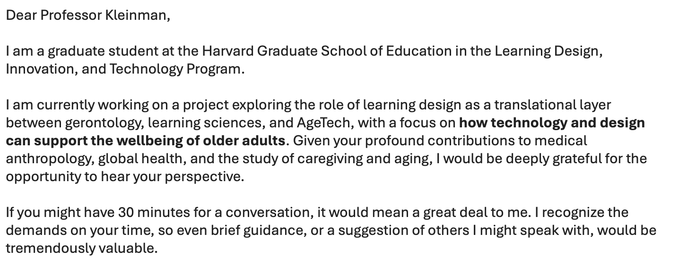
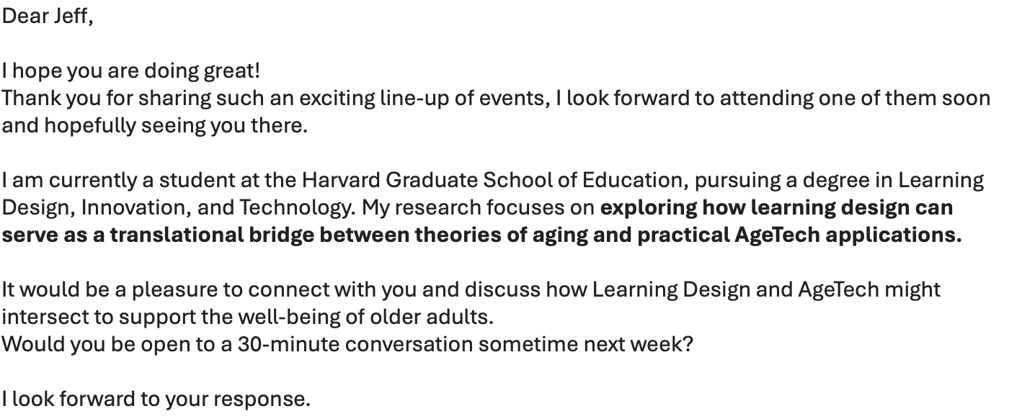
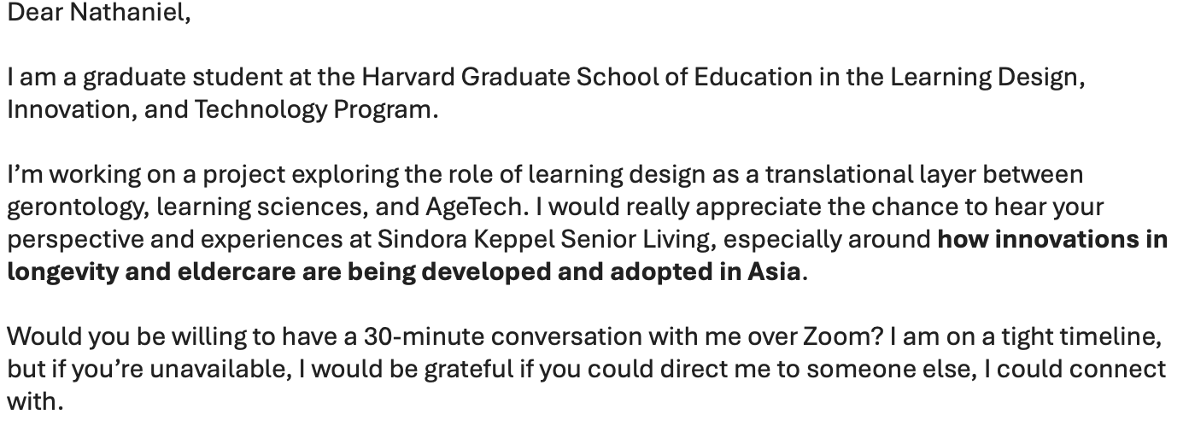
Dear Expert…

Slide 20
The Impact Ecosystem
 | Tier 1: Primary Benefit | Tier 2: Necessary to implement | Tier 3: Care about Outcome
Members | Older adults / seniors, Family caregivers | AgeTech product developers & designers Healthcare providers /Aging homes/ clinicians Insurers | Academics & researchers in gerontology, learning sciences, and public health Investors & venture capital in longevity/AgeTech NGOs & advocacy groups Employers / retirement organizations
Values | Older adults: independence, dignity, ease of use, staying mentally sharp, staying socially connected, not being treated only as patients Caregivers: peace of mind, reduced stress, trust that tech works reliably, convenience in monitoring or supporting loved ones | AgeTech product developers: adoption, engagement, differentiation in the market, evidence-based design principles that reduce product failure Healthcare providers / clinicians: tools that improve patient outcomes, reduce hospital visits/readmissions, save staff time, integrate easily with existing systems Insurers & payers lower healthcare costs, reduced claims, preventative care that delays expensive interventions, measurable ROI | Academics & researchers advancing knowledge, interdisciplinary links, frameworks that others can build upon, evidence of impact Investors & venture capital market growth, adoption rates, proven demand, clear differentiators from competitors NGOs & advocacy groups inclusion, reducing inequities, addressing underserved seniors, promoting dignity in aging Employers / retirement organizations healthy, engaged aging workforce and retirees, reduced healthcare costs, reputational gains in supporting longevity.
Evidence

Slide 21
Discussion Prompts x Expert
For each expert share the questions you plan to use to prompt the conversation. Be sure to include how you will incorporate their research or current work.
Expert:
Prompting Questions
Reasons/Questions
What are barriers or challenges
How is wellness catered at AgeTech
Who is the primary audience: caregivers or elder adults?
What innovations are working well, what is missing?
Future of AgeTech (5 years)

Slide 22
Deliverable 3 (due EOD 10/8)

Slide 23
Deliverable 3: Problem Definition with Evidence
Focus Skill: Interviewing Members of the Ecosystem
Review your Impact Ecosystem Grid for key assumptions to check. For instance, you may have assumptions about parents based on your personal experiences as a child and related research that may not be fully relevant for your specific population. Similarly, your assumptions about teachers, employees, managers, or college students, might be correct for a few but not generally true.
Develop prompting questions to get interviewees talking.
Schedule and hold multiple interviews, revising your questions and technique after each one.
Revise your Impact Ecosystem Grid and Challenge Map with the goal of narrowing your focus on one or two specific obstacles to impact. For instance, you may decide to target a mindset change (the construct) for teachers or particular technical skills for low-literacy adults. You won’t be able to solve everything, but you want to solve something.
Start mapping the construct you have chosen to target.

Slide 24
Expert |  | Context | Question themes
Nathaniel Farouz: CEO @ Sindora Keppel Senior | Thursday 2nd Oct, 10 pm | Sindora capital works as nursing and residential care facilities for seniors | Shifts in Seniors’ Needs (Global & Asia), Role of Nursing & Residential Care in AgeTech, Barriers & Structural Challenges, Learning Design & Resident Experience
Brittne Kakulla, PhD Research @ AAARP | Wednesday 16th Oct 10 am
Daniel L. Schacter Professor of Psychology (Cognitive Aging) | Thursday 16th Oct 3:30 pm |  | Learning behavior for the aging population, how cognition changes as people age, is there a way to tap on to this – if yes, what would be the key things to keep in mind.
Neil Dsouza (CEO- Get Set Up) | Tuesday, October 21st at 4 pm EDT |  | What challenges do you see What does the audience expects/wants? Where do you see the gaps in how the engagements are designed? What works?
Arthur Kleinman (professor of anthropology) | 13th Nov 1 pm

Slide 25
Is it though? Wasn’t tech always there? Then what is different about digital tech
Attach evidence for this
Technology was new to them when they were introduced to it.
Adults learn differently which is different from how children learn
Why important to address?
Technology evolves consistently– they almost always end up keeping up with the new technology
Tech products are mostly designed to solve for the problem/disease not for the human being
Assumption – explore it as another challenge area
Many senior adults finds it difficult to use the technology that is designed for them
Products when designed often aren’t co-designed with sr adults
Look for org doing this and those who aren’t
Attach evidence for this
Role of Learning design in AgeTech
AgeTech is health domain dominated
Healthcare or insurance: who bears the cost? (geography specific)
Obstacles to addressing?
V 4
Ask experts for this!
A counterargument often shared is that it is the caregiver who uses the tech [not all sr adults are primary users of the tech]
Not much research on how senior adults learn

Slide 26
Technology was new to them when they were introduced to it.
Adults learn differently which is different from how children learn
Why important to address?
Technology evolves consistently– they almost always end up keeping up with the new technology
Tech products are mostly designed to solve for the problem/disease not for the human being
Many senior adults finds it difficult to use the technology that is designed for them
Products when designed often aren’t co-designed with sr adults
Role of Learning design in AgeTech
AgeTech is health domain dominated
Healthcare or insurance: who bears the cost? (geography specific)
Obstacles to addressing?
V 4
Ask experts for this!
A counterargument often shared is that it is the caregiver who uses the tech [not all sr adults are primary users of the tech]
Not much research on how senior adults learn

Slide 27
AgeTech Design
What I think are the elements of this construct?
Holistic well being
Purpose
What is important for senior adults?
Identity and continuity
Built environment/security
Physical activity
Learning and growth across lifespan
Agency and autonomy
Relational networks of care
Economics & affordability
Physical well-being
Diet
Legacy
Place of living over device centered
Choice
intergenerational connectivity
Caregivers
Affordability
Self-awareness
Sense of self
Active learners
Learning to gain holistic well-being
Privacy & Data Concerns
Outlook/attitude
Control
Ways to connect with family and friends
Insurance structures
Cognitive
well-being
Future roles
Life-long learning
Curiosity
Adaptability
Transparent consent
Technology as a tool for connection
Ease of banking
Contribution
Faith
Financial planning
Data dignity
Purposeful engagement
Constructivism and experiential learning
Transitioning to new roles
Social well-being
Social support
Retirement planning
Ethics
Anchored in gerontological evidence on "successful aging" (Rowe & Kahn, 1997
Financial security
Dignity
Community engagement

Slide 28
Technology was new to them when they were introduced to it.
Adults learn differently which is different from how children learn
Why important to address?
Technology evolves consistently– they almost always end up keeping up with the new technology
Tech products are mostly designed to solve for the problem/disease not for the human being
Many senior adults finds it difficult to use the technology that is designed for them
Products when designed often aren’t co-designed with sr adults
Role of Learning design in AgeTech
AgeTech is health domain dominated
Healthcare or insurance: who bears the cost? (geography specific)
Obstacles to addressing?
Ask experts for this!
A counterargument often shared is that it is the caregiver who uses the tech [not all sr adults are primary users of the tech]
Not much research on how senior adults learn

Slide 29
Business value
Wellbeing of senior adults
Demographic reality
Why important to address?
Equity and access
Ethical responsibility
Inclusive technology for senior adults
Usability:
Visual (brightness), motor (slower tap precision..), cognitive
Cognitive and physical diversity Designing for such diversity demands flexible, adaptable systems
Learning barriers:
Lack of structured pathways to learn
Existing UI/UX pattern is hostile to user realities
Obstacles to addressing?
Hidden bias in designing culture
Adaptability: Digital literacy is assumed; onboarding is designed for people who already know tech
Connectivity barriers
Fragmented ecosystem

Slide 30
Conversation with Nathaniel Farouz _ Understanding the Aging Landscape
Regional Context:
Asia: Health-centric
U.S. & U.K.: Lifestyle-centric (health not always a priority)
Fundamental Needs (Across Regions):
Dignity
Connection & Social Connectedness
Agency & Autonomy
Social Identity
Emotional Drivers:
Regret of missing out — especially with technology
Enjoyment of competition & recognition (“boast about what they’ve done”) → builds social identity
Recognition functions as an emotional reward and motivator
Insight: Regardless of geography, senior adults seek meaning through social connection, identity, and self-expression — not just longevity.

Slide 31
From Health Monitoring to Meaningful Connection
How Seniors Balance Health:
Trade-offs between:
Short-term enjoyments (smoking, drinking, walking)
Security vs. Freedom (e.g., dementia → health drugs vs. active living)
Health goals are personal → they choose how to live well.
Design should help them stay motivated to meet their own goals.
Where AgeTech Can Play a Role:
Minimize health monitoring → make it empowering for seniors & caregivers.
Use digital systems to:
Stay socially connected
Free up caregiver time for human connection
Example: Automated monitoring tools that enable caregivers to focus on companionship.
Design Constructs to Prioritize:
Social Identity
Social Connectedness
Gamification → reinforces engagement with personal goals (especially in B2B contexts).
Simplify how seniors understand health and progress.
Insight: AgeTech’s real value lies in enabling connection, autonomy, and purpose, not just clinical safety.

Slide 32
Designing for Dignity & Connection
What I think are the elements of this construct?
What is important for senior adults?
What is important for senior residents home
Barriers to Adoption:
Human connection is irreplaceable
Seniors are often less tech-savvy
Wearables / companions:
Purchased but inconsistently used
May threaten social identity or feel undignified
Underlying Tension: → Over-monitoring = loss of dignity → Under-support = loss of agency → The sweet spot: Tech that empowers without replacing human touch.
Design Implications:
Shift from “health monitoring” → “human enabling”
Redefine healthy aging through agency, autonomy, and social identity
Design principles:
Respect dignity
Amplify human time, not replace it
Make tech feel socially empowering, not clinical
Insight: AgeTech succeeds when it helps seniors' live life on their own terms — connected, recognized, and free

Slide 33
How can technology reinforce identity, agency, and connection as people age?
Cognitive-friendly Interaction Layer
Motivation & Meaning Scaffold
Learning-centered Onboarding & Support
Trust, Privacy & Transparency Layer
Relational networks of care
Accessibility and usability
Agency and autonomy
Interfaces designed for slower processing & reduced working memory
Tie tasks to meaningful goals
Micro learning lessons – spaced practice
Simple, concrete privacy controls
Shared dashboards
adaptive
Sensitive to cultural norms
chunked steps
clear progressive disclosure
Delegated support models
Cultural and Contextual relevance
Just in time help
Clear explanation of data use
Inclusive
contexts
forgiving error recovery
multimodal cues (audio + visuals + haptics)
Co-learning features
Self paced
Consent by task – not buried by legal ease)
Intuitive
diversity
predictable navigation
Affordability & Access Pathways
larger targets
coached
Design for data dignity
Inter-generational
User profiles (goals, need etc)
Person-centred Profiles
Avoid one size fits all

Slide 34
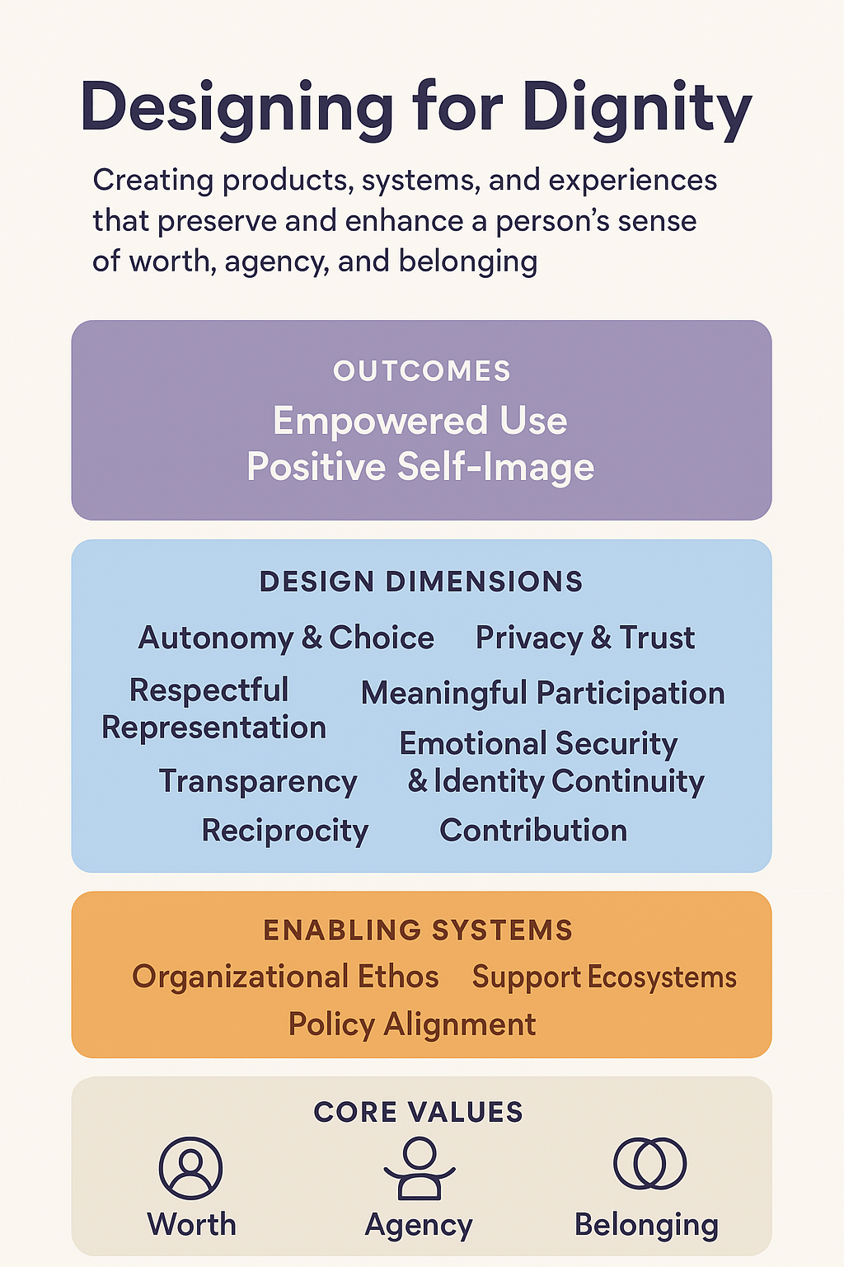
Designing for dignity
Autonomy and choice
Respectful representation
Privacy and trust
Meaningful participation
Empowered use
Positive self image
Sustained engagement
Social belonging

Slide 35
Assumptions
1. Many senior adults finds it difficult to use the technology that is designed for them | https://hollis.harvard.edu/permalink/f/1mdq5o5/TN_cdi_proquest_journals_1907285803
2. Adults learn differently which is different from how children learn
3. Tech products are not inclusive when it comes to its design | https://pmc.ncbi.nlm.nih.gov/articles/PMC10448991/pdf/gnac144.pdf Next slide
4. Products when designed often aren’t co-designed with sr adults | How to co-design with senior adults: https://pmc.ncbi.nlm.nih.gov/articles/PMC6801827/

Slide 36
Ageism in the Design of Digital Technology (Mannheim, I., et al. (2022)) Perspectives from gerontology, HCI, and STS (Science and Technology Studies)
Design Implications
Key Findings:
Older adults are often framed as passive, technophobic, or dependent, leading to paternalistic designs.
Design processes often lack co-design participation of older adults.
“Inclusive design” is frequently invoked rhetorically but rarely practiced holistically.
Psychological dimension
(Instead of just can they use it?, ask how does it make them feel?
Insights
Narratives of Deficit: Older adults positioned as lacking ability rather than possessing unique experience.
Techno-solutionism: Products often solve “aging” rather than supporting living well while aging.
Tokenism in Inclusion: Older adults engaged late in design (testing, not ideation).
Design Gaps: Few projects integrate psychosocial or cultural dimensions of aging—focus remains on usability and safety.
Cultural dimensions
(how is aging and technology interpreted within context?)
Experiential and emotional design (creating technology that supports living well, not just aging safely)
error prevention | vs | joy enablement
Can they use it safely? |  | Does it make hem feel capable and valued?
Is it accessible? |  | Is it meaningful and empowering?
Is it usable? |  | Does it enrich identity, purpose, and connection?
“Ageism in design is not just attitudinal—it is infrastructural, embedded in how problems are defined and who is invited to solve them.”

Slide 37
The Impact Ecosystem
 | Tier 1: Primary Benefit | Tier 2: Necessary to implement | Tier 3: Care about Outcome
Members | Older adults / seniors, Family caregivers | AgeTech product developers & designers Healthcare providers /Aging homes/ clinicians Insurers | Academics & researchers in gerontology, learning sciences, and public health Investors & venture capital in longevity/AgeTech NGOs & advocacy groups Employers / retirement organizations
Values | Older adults: independence, dignity, ease of use, staying mentally sharp, staying socially connected, not being treated only as patients Caregivers: peace of mind, reduced stress, trust that tech works reliably, convenience in monitoring or supporting loved ones | AgeTech product developers: adoption, engagement, differentiation in the market, evidence-based design principles that reduce product failure Healthcare providers / clinicians: tools that improve patient outcomes, reduce hospital visits/readmissions, save staff time, integrate easily with existing systems Insurers & payers lower healthcare costs, reduced claims, preventative care that delays expensive interventions, measurable ROI | Academics & researchers advancing knowledge, interdisciplinary links, frameworks that others can build upon, evidence of impact Investors & venture capital market growth, adoption rates, proven demand, clear differentiators from competitors NGOs & advocacy groups inclusion, reducing inequities, addressing underserved seniors, promoting dignity in aging Employers / retirement organizations healthy, engaged aging workforce and retirees, reduced healthcare costs, reputational gains in supporting longevity.
Evidence | Next slide

Slide 38
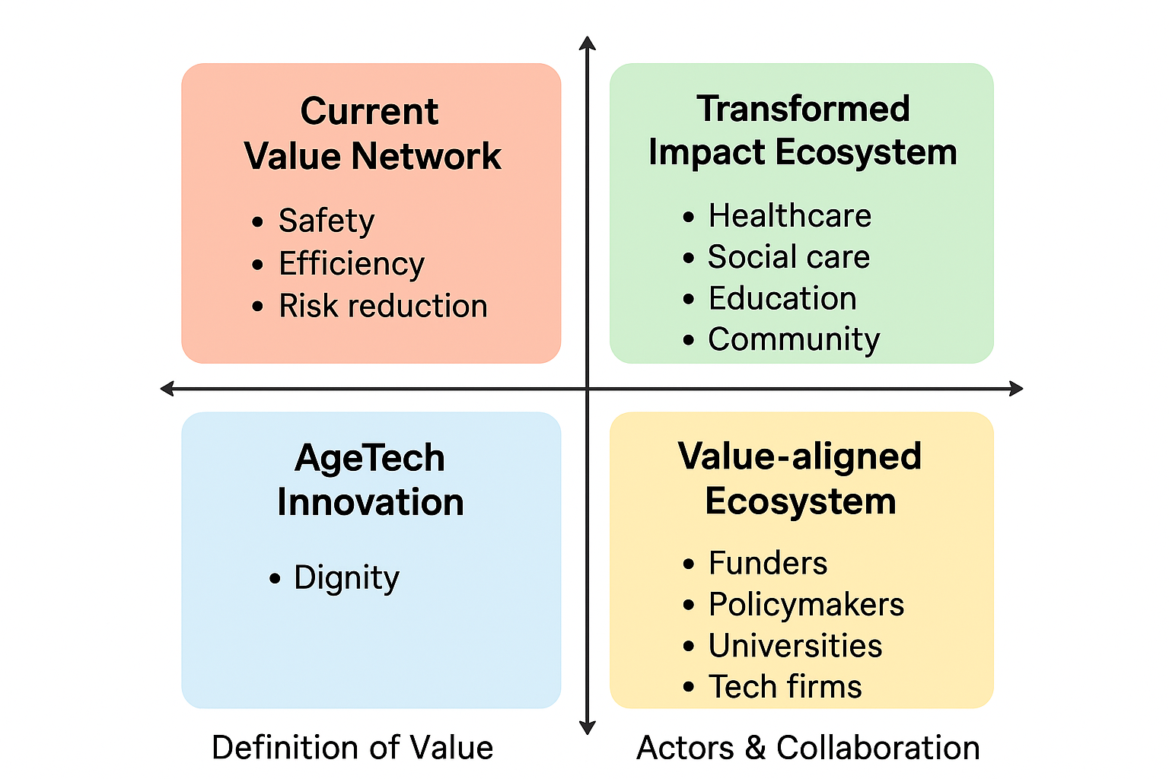
Evidence/Value Networks (long term)
Ecosystem leverage :How can you help reframe “success” in aging — not as dependency minimized, but as agency sustained?
bridge-building — using partnerships and shared metrics to realign the system.
Which partnerships move you toward the Value-Aligned Ecosystem

Slide 39
Deliverable 4 (due EOD 10/22)

Slide 40
Deliverable 4: Theory of Action
Focus Skill: Evidence-Inspired Ideation
Impact follows changes in behavior. Articulate the changes you want to hear and see for specific members of the Impact Ecosystem on the Start State-End State tool. For instance, to improve the mental health of adolescents under constant academic and social pressure, you may decide that parents need to change the way they interact with them. You can’t design for those changes if you can’t describe them.
Use your descriptions to draft How might we…? ideation prompts.
Participate in a rollicking ideation exercise to generate A LOT of ideas.
Visualize and test your idea with Show, Don’t Tell.
State your selected idea as a specific Theory of Action: If (target member of ecosystem does something)...then (behavior change)...so that (desired outcome).

Slide 41
Conversation with Brittne Kakulla (AARP) _Understanding Older Adults’ Relationship with Technology
Context of the Discussion
Focus: How older adults perceive and engage with technology
Lens: Design, behavior, and inclusion
Central Insight:
Co-creation and low-stakes exposure are essential. Learning design principles can guide how older adults build confidence, connection, and trust with technology.
Foundational Barriers Identified:
Self-ageism and fear of embarrassment
Stereotypical assumptions (“they’ll fumble with tech”)
Overconfidence in current habits (“What I’m doing is fine”)
Fragmented experiences and lack of trusted intermediaries
Design Levers for Change:
Co-creation and participatory design
Learning through play (gamification, low-stakes contexts)
Building tech literacy through familiarity, repetition, and relevance

Slide 42
Broad Themes
Themes | Brittne’s Interpretation | Design Implications
Co-Creation and Participatory Design | Brittne emphasized co-design with older adults, not design for them. She sees accessibility as integral, not an add-on — similar to how inclusive learning design treats UDL. The underlying message: “Design literacy” and “tech literacy” must develop together — this is your learning design entry point. | → Learning design can offer frameworks (like UDL, participatory pedagogy, and formative feedback cycles) to structure co-creation processes in AgeTech. → This aligns with your “translational layer” idea: learning design helps translate what older adults know and prefer into design principles.
Overcoming Stereotypes and Self-Ageist Barriers | Older adults internalize cultural narratives that they can’t learn or don’t need to. This is an emotional/identity barrier — not just skill-based. Their Jobs To Be Done are tied to identity and purpose, not novelty or performance | → Learning design can reframe tech use as identity-affirming and low-stakes learning. → You might define Design for Dignity and Confidence as a construct — similar to how learning scientists design “safe failure spaces” for learners.
Motivation, Gamification, and “Learning by Doing” | Motivation among seniors is intrinsic and wellbeing-oriented (joy, mastery, connection) rather than extrinsic (points, achievements). Gamified micro-learning aligns with their cognitive and emotional patterns — repetition, small wins, meaningful contexts. | You can connect gamification to learning design for wellbeing. → Learning design helps translate cognitive principles (like spaced repetition, intrinsic motivation) into UX design for AgeTech.

Slide 43
Broad Themes
Themes | Brittne’s Interpretation | Design Implications
Social Connection and Real-World Extension | The most powerful AgeTech products bridge online engagement and real-life belonging. Tech is seen as an enabler of social learning, not a replacement for human interaction. | → Learning design can position social learning theory (Vygotsky, Lave & Wenger) as a design lens for community-driven AgeTech. → You could coin or refine the construct Socially-Connected Design for Aging.
Trust, Transparency, and Cognitive Simplicity | Trust isn’t just a feature — it’s a learning condition: seniors must understand what’s happening. They rely on trusted intermediaries (family, brands, caregivers). | → Learning design can inform trust-building communication (explainability, guided onboarding, repeated exposure). → Your translational framework could integrate trust literacy as a design dimension — similar to health literacy.
Tech Experience Expectations | The expectation is not more tech, but integrated, empowering experiences. Agency and autonomy define perceived usefulness. | → Learning design can contribute models for adaptive, self-directed systems — where the user feels in control of their journey, not managed by algorithms. → This aligns with UDL’s principle of engagement and multiple means of action and expression.

Slide 44
Learning design doesn’t just “translate” between gerontology and AgeTech — it operationalizes agency, trust, and connection in design.
Design Principles Emerging from Insights
Identity-Affirming Design
Counters self-ageism, reinforces agency and confidence.
Enables self-directed exploration (“help me reach my goals”).
Gamified or low-stakes experiences to reduce fear of failure.
Socially-Connected Design
Facilitates meaningful connections (“find your tribe”).
Moves beyond engagement to belonging.
Encourages intergenerational and community-based participation.
Trust-Building Design
Builds comprehension and safety through transparent, plain language.
Reduces cognitive load by making systems seamless and consistent.
Recognizes that privacy, control, and data clarity are expectations.
Integrative & Empowering Tech
Seamless, not fragmented.
Household-level usability (caregivers + seniors).
“Save me time, money, and help me stay healthy — but let me control how.”
Gerontology defines what matters (needs, values, cognition).
AgeTech defines what’s possible (tools, interfaces, systems).
Learning design defines how humans adapt, co-create, and stay confident with those tools.

Slide 45
Observable Changes in Behavior
The Problem: Products are designed for senior adults and not with them
Start State (Passive Recipient) | Behaviors (from obstacles) | End State | Behaviors that leads to end state
Older adults are positioned as end-users, not co-creators. We are testing the product with the audience, that’s co-creation | Usability is prioritized over sustained usability Dominance of stereotypes | Demonstrated impact: users report ease, meaning, or empowerment. Seniors' express ownership A replicable framework exists: design principles can guide future AgeTech or learning design projects.
Psychological dimension
(Instead of just can they use it?, ask how does it make them feel?
Accessibility dimension
(is the aging tech accessible for all subgroups of aging population
Cultural dimensions
(how is aging and technology interpreted within context?)
Safety dimensions
(Is the tech and its terms of use transparent and simple to understand)
Experiential and emotional design (creating technology that supports living well, not just aging safely)

Slide 46
Behavior change Map
Problem: Products are designed for, not with, older adults
Goal: Older adults co-create, influence, and meaningfully engage with technologies that reflect their needs, values, and identities.
Passive Recipient | Informed Participant | Empowered Co-Designer
Older adults are positioned as end-users, not co-creators. They often feel studied, misunderstood, or patronized. | Designers start to treat their perspectives as data sources, not afterthoughts. | Older adults now shape design decisions; they see technology as an extension of their identity and agency.
Participate in testing after design decisions are made. Use technology minimally or only when “necessary.” Express self-limiting beliefs (“I’m not good with tech,” “This isn’t for me”). Accept design friction or workarounds quietly. See technology as useful, but not personal or empowering | Share detailed stories of use, frustration, and workarounds. Respond positively when design language becomes inclusive and human. Volunteer to “show” rather than just “tell” how they use technology. Engage in early-stage feedback sessions. Begin to question assumptions about “what seniors want.” | Participate in ideation, not just testing. Suggest new features or metaphors (“Why not make this like a conversation?”). Use the technology creatively — beyond intended use cases. Mentor peers or caregivers in using tech. Advocate for inclusive design in their communities.

Slide 47
Potential How Might We…Prompts
How might we get dignity/empathy as a design principle
How might we get products to be co-designed with senior adults
How might we design affirms identity
How might the design enable Social-Connectedness
How might we have seamless and not fragmented systems of technology
How might we have designs that builds trust

Slide 48
Theory of Action
Construct of empathy – designed into a simple product)
If empathy/dignity becomes a working design value then AgeTech can shift from seeing aging as a declining to empowering so that senior adults can feel confident and empowering about

Slide 49
Theory of Action
We all are here away from our parents/grandparents – it gets difficult to stay connected all the time – either its them checking with you or you checking on them for meds/health/family events.
If this is something that you struggle with – what are the struggle points?
What could help you or your parents?
If AgeTech can design for senior adults to feel socially connected, then they will feel more empowered, enabling them to maintain dignity and independence in daily life.

Slide 50
Theory of Action
An interactive evaluation tool for AgeTech products that operationalizes the framework into practice
If designers and companies co-create products with senior adults while applying Age Design Principles, then senior adults will feel more confident, respected, and capable in using these products, so that they can maintain their dignity and independence in daily life.

Slide 51
AgeTech Design Assessment Tool — MVP
Design Foundations for Aging-Inclusive Technology
A single-page interactive visual reference that presents the full research-backed framework for aging-inclusive design. This distills the “what” — the 5 big ideas and 15 key approaches that form the foundations of aging-inclusive technology design.
An interactive evaluation tool that operationalizes the framework into practice for AgeTech teams. It guides product teams/organizations through 62 structured questions aligned to the five big ideas with smart filtering based on product stage (Idea → Launched), sector context, well-being domains, and big ideas users want to assess.
This serves as the “how” — turning academic insights into a practical, usable assessment system that brings evidence-based design within reach for product teams.
The tool is still in iterative refinement, informed by ongoing early user testing to ensure clarity, relevance, and applicability across different AgeTech contexts.

Slide 52
Deliverable 5 (due EOD 11/5)

Slide 53
Deliverable 5: Minimal Prototype Revision History
Focus Skill: Iteration
You won’t get it right the first time, and you won’t know how you are off track without feedback. You have to put your ideas out there, and the less invested in them you are, the more open you will be to revisions. Your goals are to learn and improve your design. Design the most minimal prototype to see if you are on the right track in driving the behavior change you want. Can you get a disengaged student to lift their head off the desk? Can you get a parent to pause instead of automatically harping about performance? Can you generate a small change in the direction of something bigger?
Test, revise, and retest. Start with low stakes audiences, like peers and classmates. Gradually increase the stakes as you get promising responses.
DO NO HARM.

Slide 54
Updated Impact Ecosystem
What variability matters? What matters to each of them – what can be the design for them
How do I figure out what I need to anticipate?
What’s role does human have in investigating for variability and how can tech help in that?
 | Tier 1: Primary Benefit | Tier 2: Necessary to implement | Tier 3: Care about Outcome
Members | Senior adults (user) – 1. 40 – 50 2. 50 – 60 3. 60 – 70 4. 70 – 80 Caregivers – Family members Nurse | Product designers Investors | Multilateral systems
Values | Jobs to be done Care Identity affirmation | product developers: adoption, engagement, differentiation in the market, evidence-based design principles that reduce product failure Investors & venture capital market growth, adoption rates, proven demand, clear differentiators from competitors | Academics & researchers advancing knowledge, interdisciplinary links, frameworks that others can build upon, evidence of impact NGOs & advocacy groups inclusion, reducing inequities, addressing underserved seniors, promoting dignity in aging
Evidence | Ease of use/Comfort with the product | Adoption numbers Sustained usability How well co-creation is implemented? Integrated systems | Implementable frameworks – theory Impact numbers (well being quotient)

Slide 55
My Assumptions and Updates (including from MVP testing, interviews, and research)
1 | I believe design teams would use the tool to reflect on the design of their product from the lens of needs of the aging population
2 | I believe at an ideation stage, if the principles are adopted, the products will be inclusive and holistic

Slide 56
How can technology reinforce identity, agency, and connection as people age?
What I think are the elements of this construct?
What is important for senior adults?
What is important for senior residents home
Cognitive-friendly Interaction Layer
Motivation & Meaning Scaffold
Learning-centered Onboarding & Support
Trust, Privacy & Transparency Layer
Relational networks of care
Accessibility and usability
Agency and autonomy
Interfaces designed for slower processing & reduced working memory
Tie tasks to meaningful goals
Micro learning lessons – spaced practice
Simple, concrete privacy controls
Shared dashboards
adaptive
Sensitive to cultural norms
chunked steps
clear progressive disclosure
Delegated support models
Cultural and Contextual relevance
Just in time help
Clear explanation of data use
Inclusive
contexts
forgiving error recovery
multimodal cues (audio + visuals + haptics)
Co-learning features
Self paced
Consent by task – not buried by legal ease)
Intuitive
diversity
predictable navigation
Affordability & Access Pathways
larger targets
coached
Design for data dignity
Inter-generational
User profiles (goals, need etc)
Person-centred Profiles
Avoid one size fits all

Slide 57
MVP Iteration History
Share highlights of your iterations (stories, images, etc.).
Design foundations
Key design principles that can inform product design
Assessment tool
Informed by the design foundations, the tool scores products on how inclusive they are to meet diverse needs of its users.
Added filters for focused evaluation
To add depth and focus to the evaluation, the following filters were added basis feedback received from product developers, founders - product stage, well-being focus, and industry of the product
Enhancing Questions (ongoing)
Changing the language of the questions from generic to product language
Personalized report

Slide 58
Deliverable 6 (due in-class 11/19)

Slide 59
Deliverable 6: Evidence of Your Competence
Focus Skill: Articulation
Design doesn’t happen in isolation. You work with a team to engage experts and the impact ecosystem. You need to be able to communicate clearly and concisely. You may also need to convince others to join or hire you. Collect and organize the assets you have accumulated over the semester.
Pick an audience you want to convince of your competence. It could be potential customers of what you hope to design. It could be colleagues you want to join you on a mission. It could be a future employer or a potential funder.
Craft a maximum 2-minute pitch for the audience of your choice on how you or your work can generate impact by design.

Slide 60

2030
One in six people in the world will be aged 60 years or over.
Source: WHO

Slide 61
Age Tech
Notes:
This demographic shift is already creating profound wellbeing challenges

Slide 62
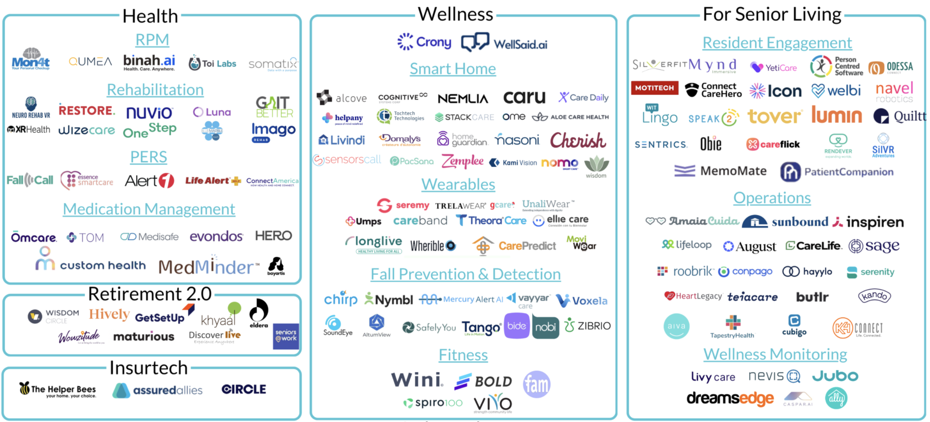
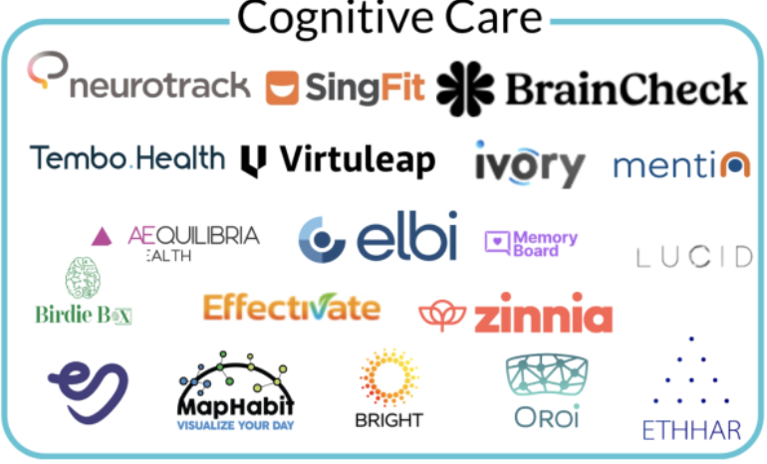
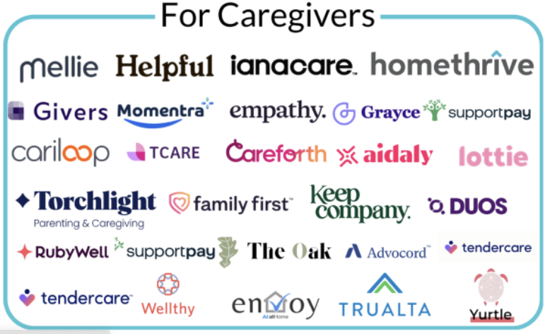
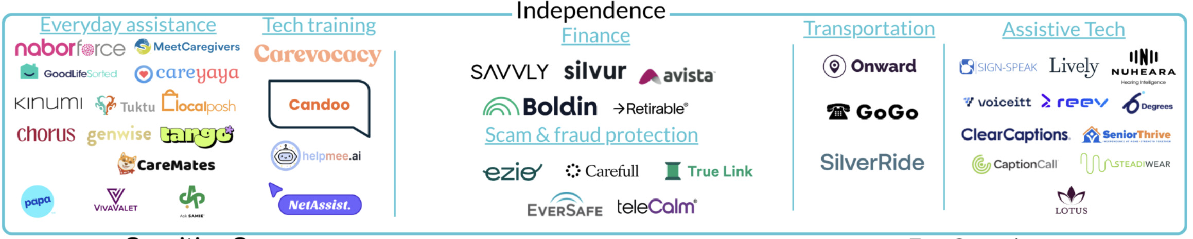
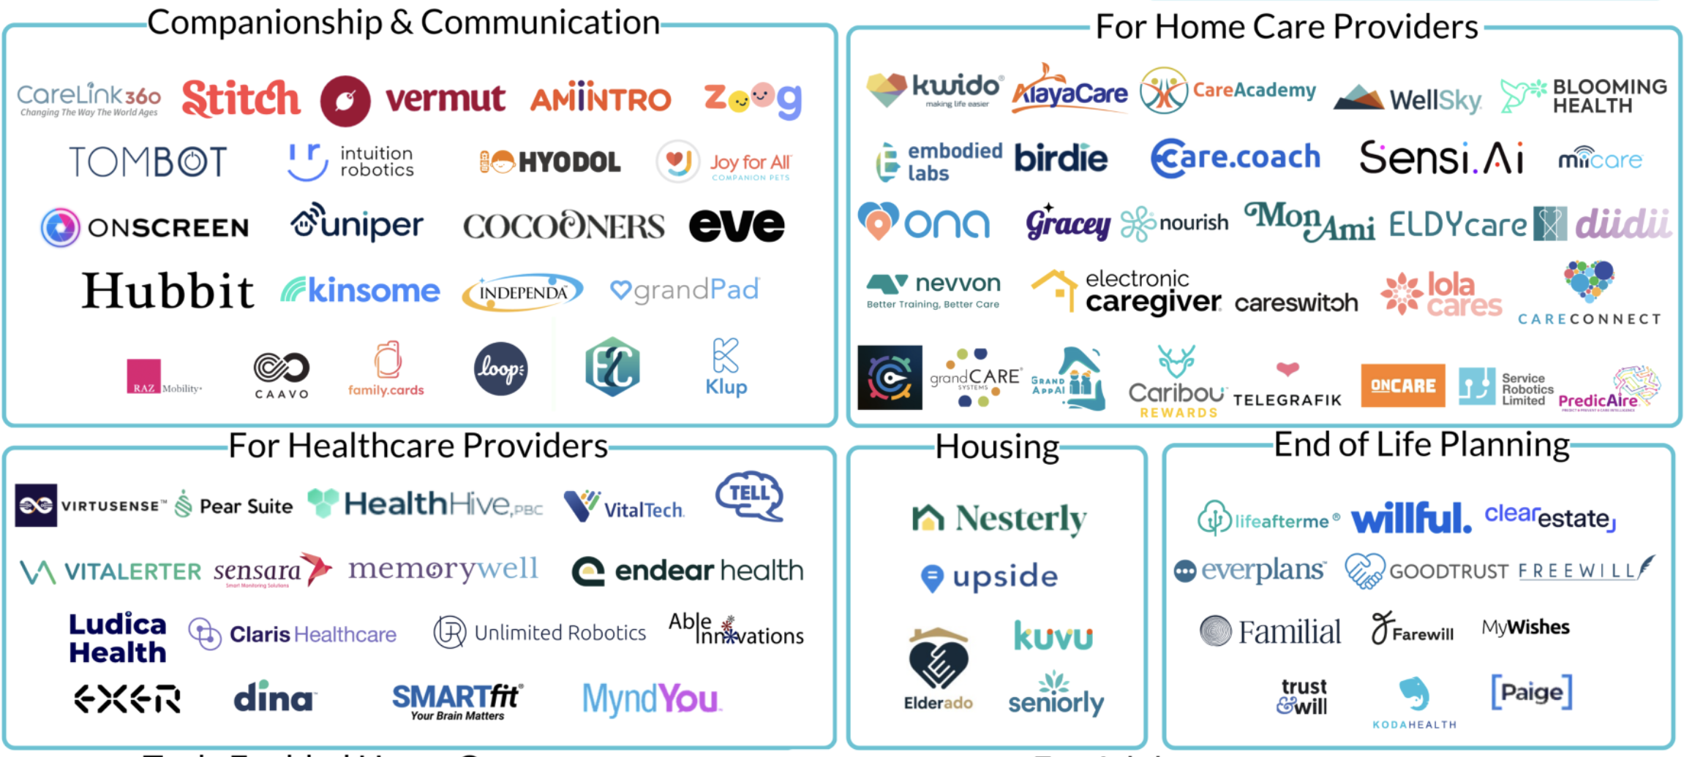
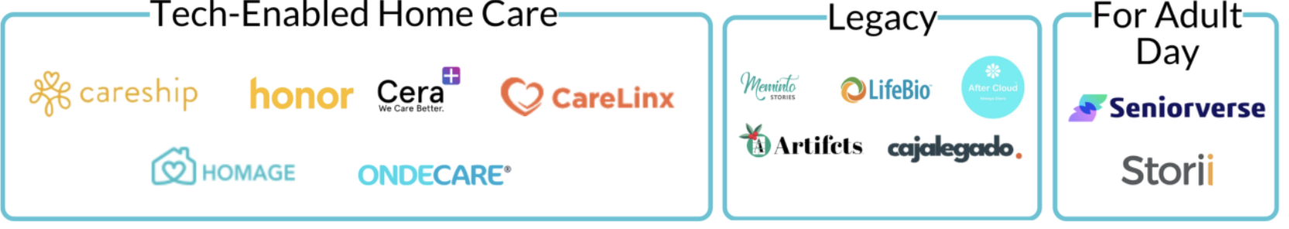
Age Tech
2025
Market Map
Source: https://thegerontechnologist.com/

Slide 63
Demographic Reality
Loneliness and social isolation are key risk factors for mental health conditions
1 in 6 seniors experience abuse
Approximately 14% of adults aged 70 and over live with a mental disorder.
Mental disorders among older adults aged 70 years or older account for 6.8% of the total years lived with disability for this age group.
Millions retiring in the next 5 years lack adequate support or planning
Source: WHO
Notes:
This demographic shift is already creating profound wellbeing challenges

Slide 64






The Disconnect - Market
What research says
What Age Tech delivers
Notes:
Age-tech currently delivers isolated solutions instead of integrated solutions that impacts their overall wellbeing.

Slide 65


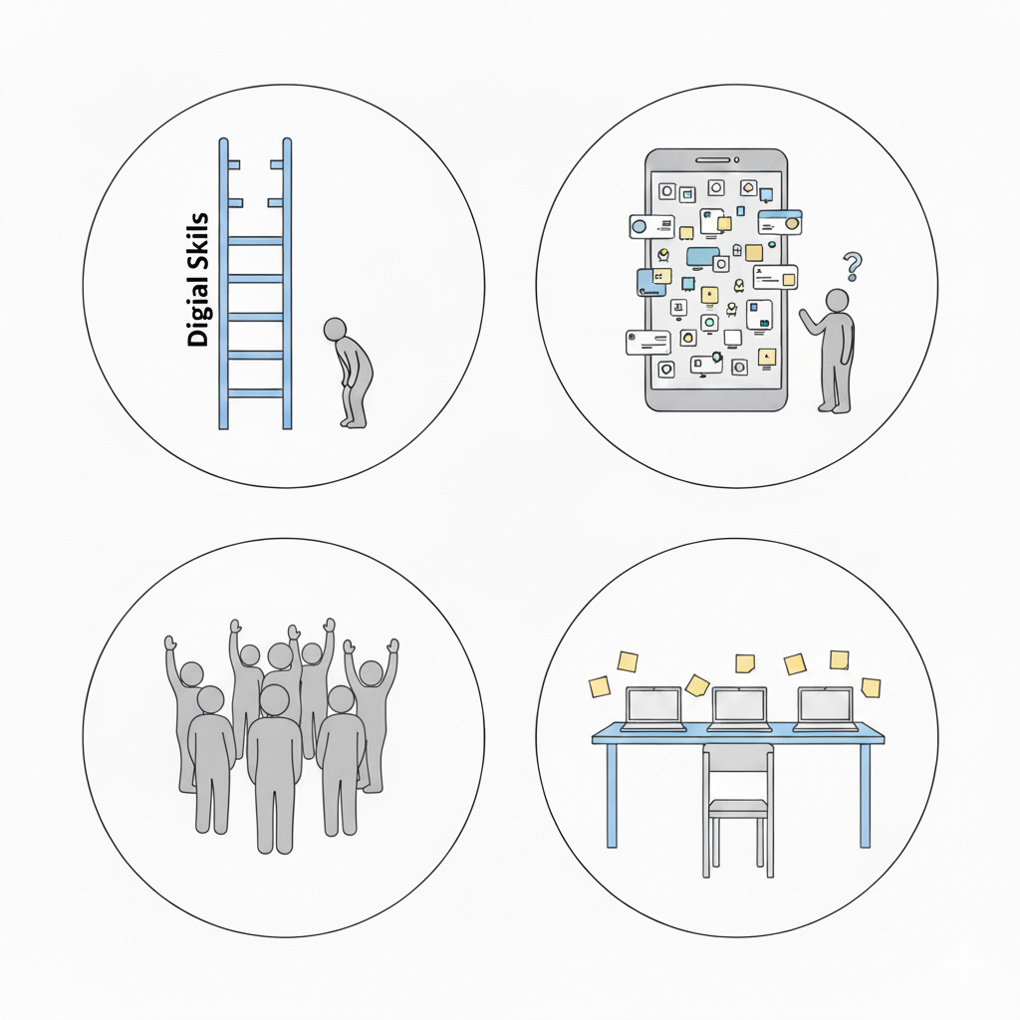
The Disconnect - User
2025
50+
Global data on digital readiness (ITU) 2023, shows persistent gaps in digital literacy among older adults.
AARP 2024 Tech Trends: 59% of adults say technology is not designed with their age in mind.
OECD, usability studies show that older users are often under-represented in testing and design processes, which leads to usability issues
AARP 2025 Tech Trends: 71% of adults are interested in tech support services for older adults

Slide 66
The Digital Divide: Created by Design, Not Capability
Barriers
Digital literacy assumed from the start
Inadequate onboarding processes
Rapid technology evolution without learning pathways
Ageism – self and industry
Critical finding
Older adults do not lack awareness or digital know how. They lack structured support to learn how to use it.
Result
A population systematically excluded from tools that could enhance their wellbeing—not because they cannot learn, but because the learning infrastructure doesn't exist.

Slide 67
So what designs do we need to close this gap?

Slide 68
Design Foundations for Aging-Inclusive Technology
Five Evidence-Based Big Ideas with Key Approaches for Creating Technology for Older Adults

Slide 69
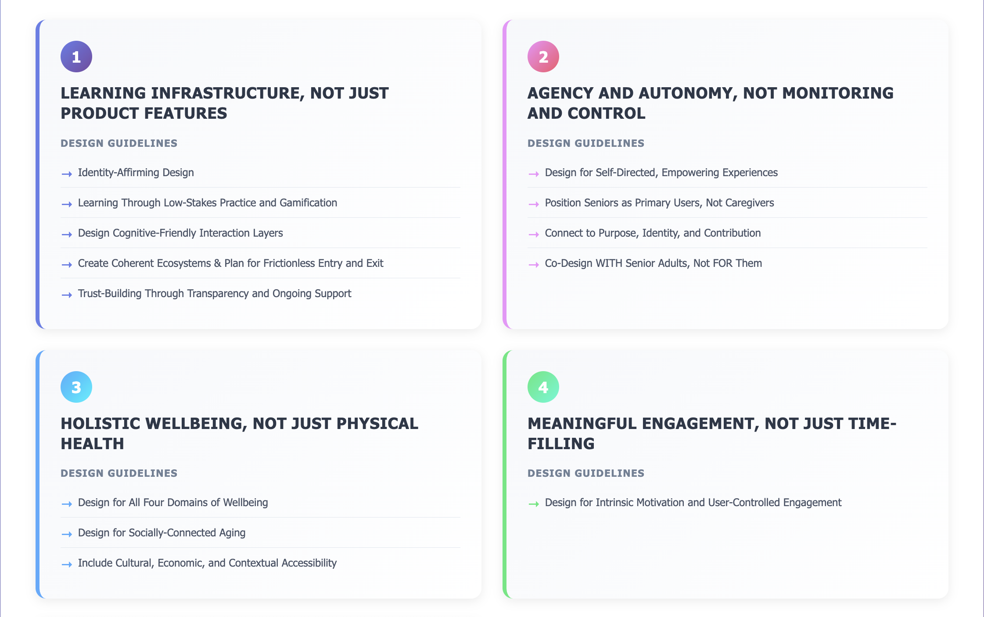
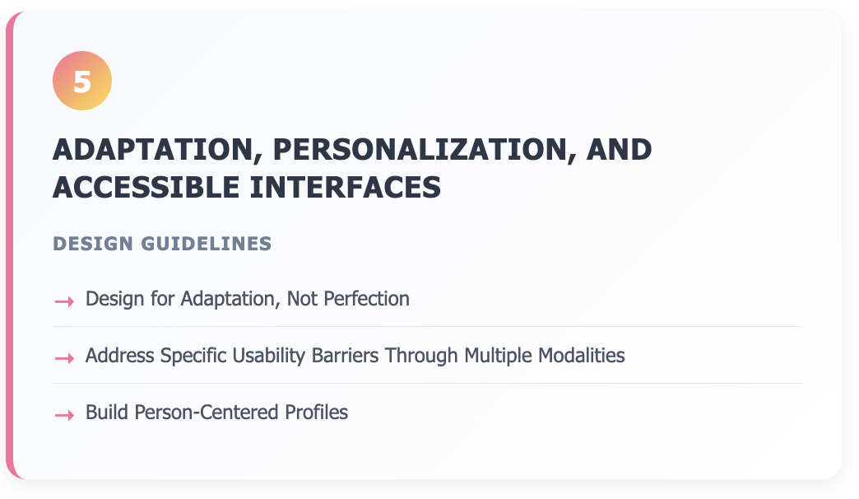
MVP 1: Design Foundations for Aging-Inclusive Technology
Notes:
Learning infrastructure – gives agency and autonomy – is focused on holistic well-being, drives meaningful engagement – and interfaces that are accessible.

Slide 70
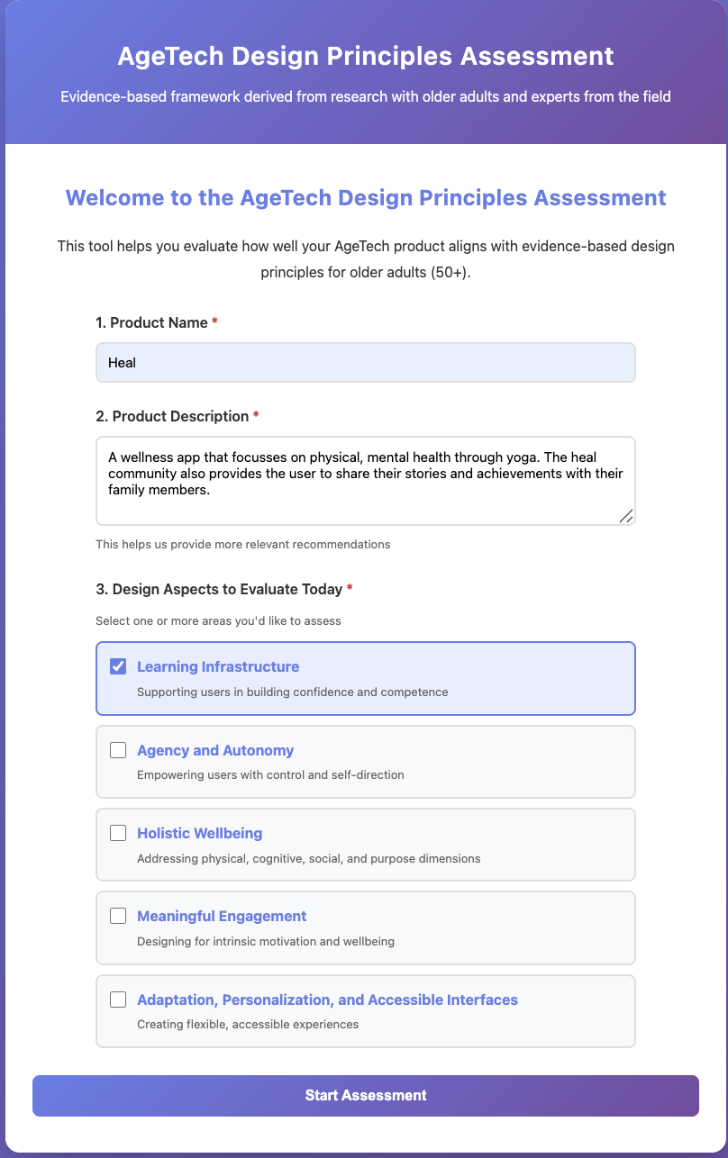
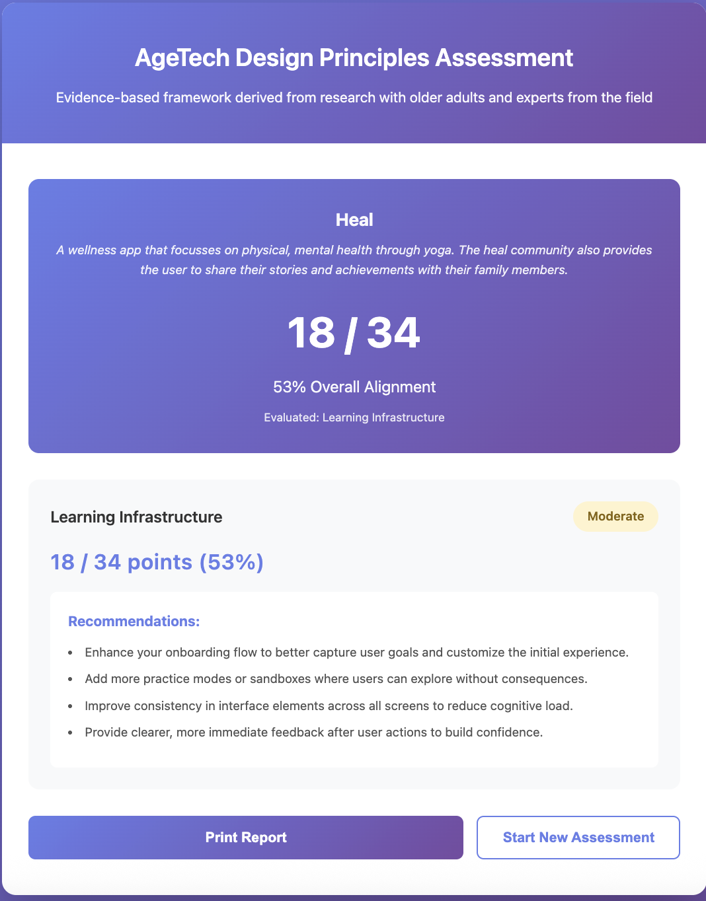
MVP 2: Reflective Tool to assess age-inclusive design quality

Slide 71
Designing the Missing Layer (empathy) in Age Tech
If products are co-designed with older adults and are based on the Design Foundation Principles then technology becomes learnable, usable, and supportive of aging, so older adults move from simply having access to tech to actually benefiting from it.

Slide 72
Thank You!

Slide 73
Performance Review
Link to relevant assets

